Slide 1
LN2 PROCESS FLOW
ROUGH DRAFT

Slide 2
Instrumentation Hazards, Tools, Parts, PPE
Hazards:
Solder Fumes, Welding Arc, Burns, Cuts
Tools:
Milwaukee Hand Drill, 5/8 Allen wrench, 3/8 Allen Wrench, Wire strippers, Knipex cutters, C clamps, Soldering Iron, Solder fume extractor, Spot welder,
Parts:
Consolidated 26(7) Blue wire, Consolidated 26(7) Orange Wire, Hose Clamps, 2mm shim spacers, 44 Sn40Pb60 Rosin Solder
PPE:
Safety Glasses, Gloves (unsuitable for rotating parts), Welding Glasses

Slide 3
Silver plating Hazards, Tools, Parts PPE
Hazards:
Fumes, Skin Eye irritant, Flammable, Toxic, Corrosive, Electrical Hazard
Tools:
Rapid Portable Plater, Silver Plating Activator, Silver Plating Solution- Coatalyte, Activator swab, Silver Plating Wand, Fume Extractor
Parts:
Silver Plating Activator, Silver Plating Solution- Coatalyte, Sleeve NO. 31-P, Light duty White Scotch Brite, Ultra Fine Gray Scotch brite, General Purpose Red Scotch Brite
PPE:
Safety Glasses, Gloves , Lab Coat, 3M Respirator, hood Pappr

Slide 4
Verify all previous steps have been completed before proceeding
Ensure cable is prepped and ready to proceed to Test instrumentation

Slide 5
Place cable clamps to hold cable In place
Use hose clamps to replace the clamping locations of the test cable that’s being held by clam shells.

Slide 6
Remove clam shells
After each clamp shell has a hose clamp on each side begin removing clam shells.
Store removed clam shells on the PF holding shelf adjacent to winding.

Slide 7
Remove metal pins
Slowly work your way around the cable using the pry tools available to release pins from the cable.
DON’T throw pins into the trash, store them in a bin, and return to winding.

Slide 8
Use plastic shims to create a 2mm gap spacing
Release tension as needed from the hose clamps.
Insert 2mm shim spacers into gaps turns at 1/8 pancake sections.

Slide 9
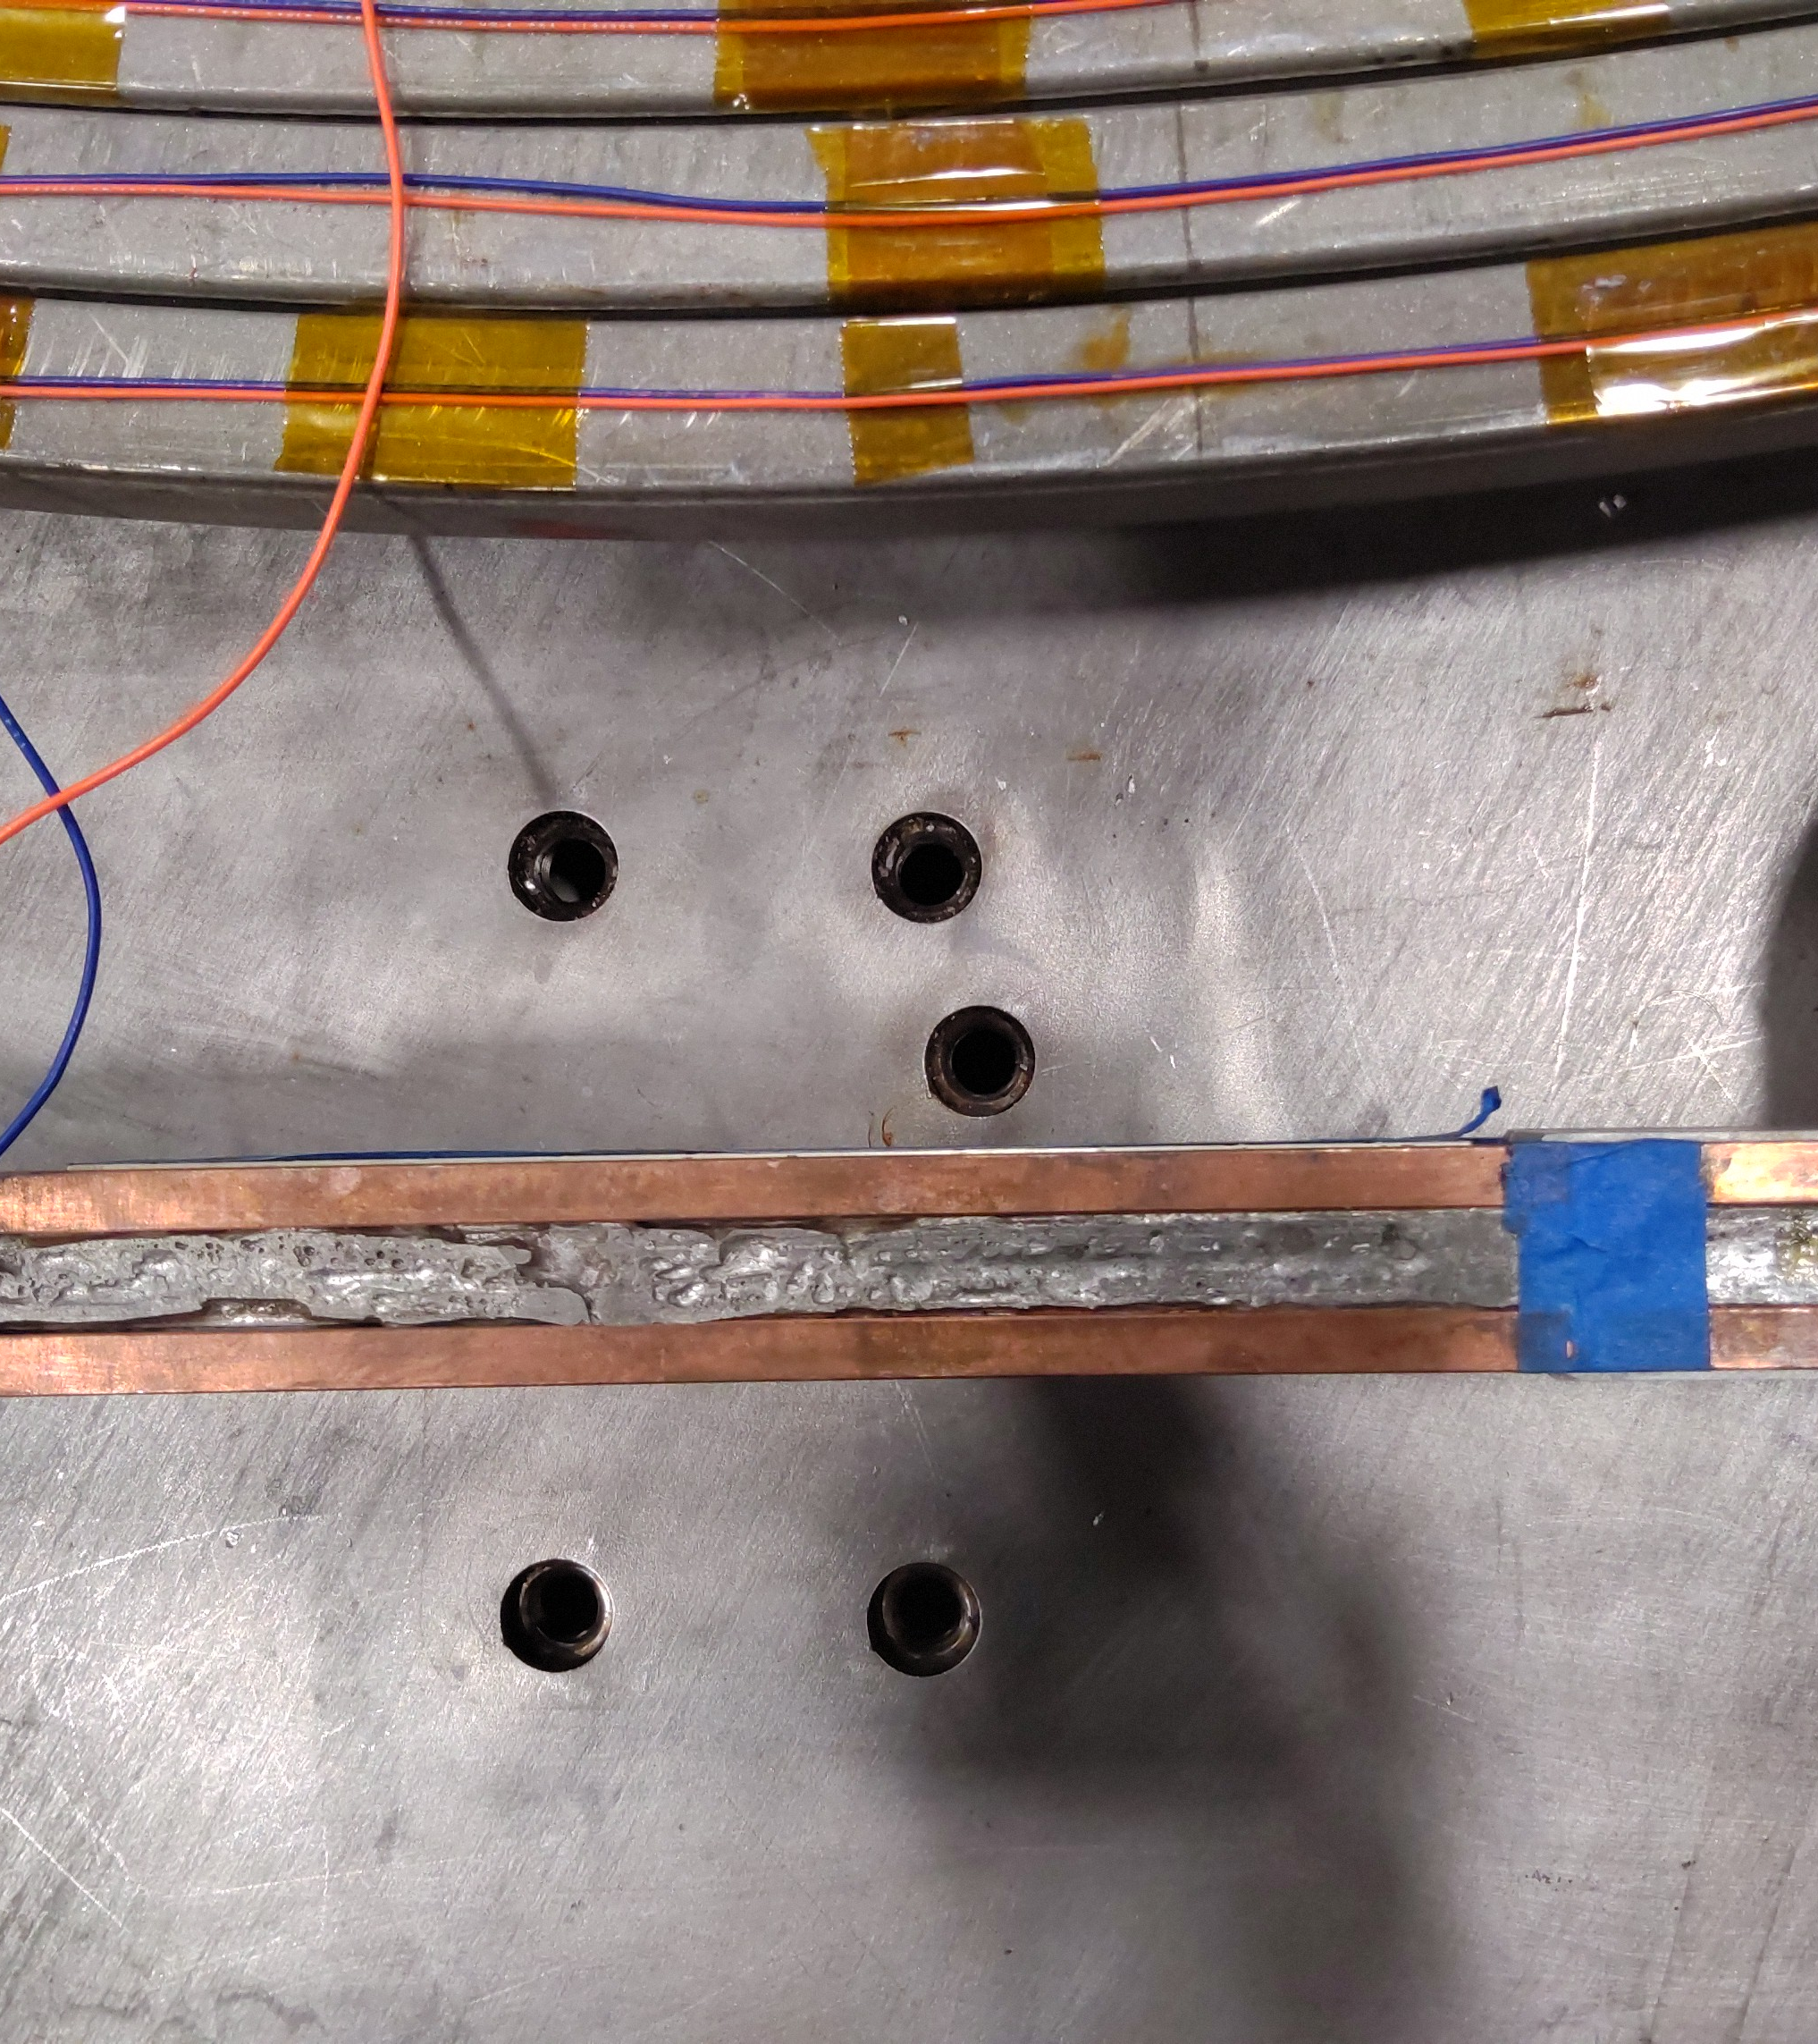
Adjust Cable locations
Joggles have landing locations on the fry basket and are critical to land busbars to adapter locations.
Landing location at the centroid of the joint region relative to the centroid of the four screw hole locations.

Slide 10
Verify before proceeding
Cable clamps are holding the cable in place
Shims have been replaced with nonmetallic materials
Joint region has been centeralized

Slide 11
Mark spot welding locations
Locate and verify the universal instrumentation map either provided or printed out.

Slide 12
Missing instrumentation Map
If an instrumentation map is not available, generate one by printing the necessary sections and assembling them by cutting and taping the corners to form a complete map.
https://drive.google.com/drive/folders/1ixtibYRzg7C_H6VkZFzLuxyW004w4q_y

Slide 16
Silver Plating

